Slide 1

CONFIGURABLE NEUROMORPHIC PROCESSOR ARCHITECTURE FOR SPIKING NEURAL NETWORKS
R.M.T.N.K Rathnayaka (E/17/286)
Supervised by Dr. Isuru Nawinne
Department of Mechanical Engineering
Faculty of Engineering
University of Peradeniya
ME420- Mechanical Engineering Individual Research Project
Progress Evaluation
August, 2023

Slide 2

CONTENT
Title
Introduction
Literature review
AIM of the project
Objectives
Learning outcomes
Methodology
Current Progress
Timeline
Reference

Slide 3
INTRODUCTION

Slide 4
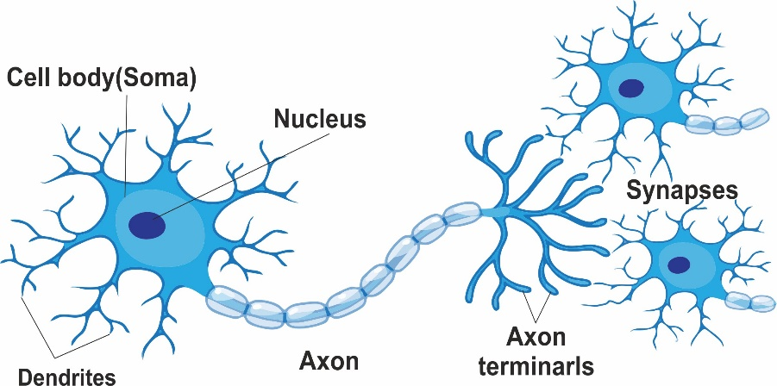
INTRODUCTION
What is a Neuron?
A neuron is a specialized cell in the brain that processes and transmits information through electrical and chemical signals, forming the basis of all cognitive functions

Slide 5


INTRODUCTION
What is a Neural Netwok?
Complex interconnected system of neurons in the nervous system of animals, including the human brain, that work together to process and transmit information through electrical and chemical signals

Slide 6


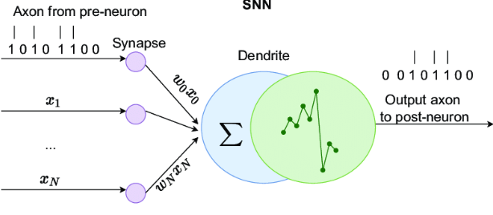
INTRODUCTION
What is a Artificial Neuron?
An artificial neuron mimics the behavior of biological neurons, processing inputs through weights and biases to produce an output, forming the building block of neural networks.

Slide 7
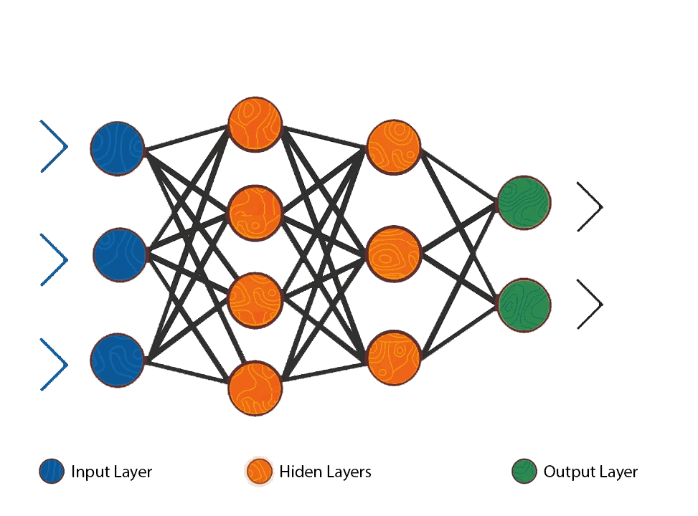
INTRODUCTION
What is a Artificial Neural Network?
Computational model composed of interconnected artificial neurons, designed to learn and perform tasks by adjusting weights through training, inspired by the structure and function of biological neural networks

Slide 8
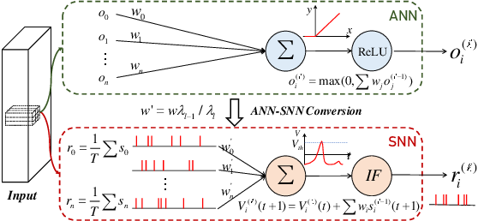
INTRODUCTION
What is a Spiking Neuron
A computational model that simulates the behavior of biological neurons more closely by considering the timing and frequency of individual spikes

Slide 9
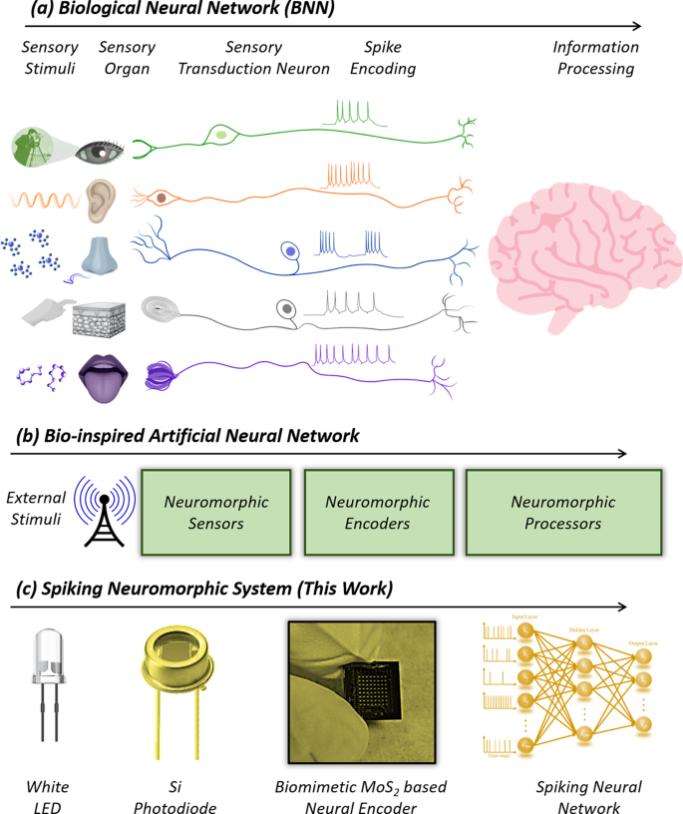
INTRODUCTION
What is a Spiking Neuron

Slide 10

Spiking Neuron networks
Spiking neural networks introduce a more biologically accurate approach by modeling the timing of neuron spikes, potentially enhancing temporal information processing compared to traditional artificial neural networks,

Slide 11
INTRODUCTION
What is Spiking Neural Networks?
Spiking neural networks (SNNs) are a type of neural network that simulate the behavior of biological neurons and synapses.
The significance of SNNs lies in their ability to mimic the behavior of biological neural networks and in their potential for improving machine learning and artificial intelligence.
The basic components of an SNN include neurons, synapses, and input/output spikes.

Slide 12
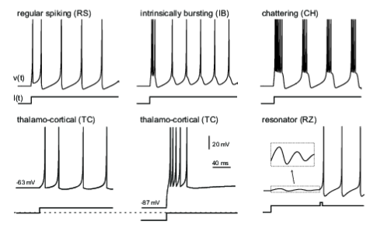
INTRODUCTION
Unlike traditional artificial neural networks (ANNs), which use abstract mathematical models, SNNs process information through the timing and frequency of spikes.
SNNs can be used for a variety of applications, such as speech recognition, image processing, and robotics.
Compared to ANNs, SNNs offer potential advantages such as better energy efficiency and higher accuracy.

Slide 13
INTRODUCTION
What is Neuromorphic Engineering?
Neuromorphic computing is an approach to computing that uses hardware and software inspired by the principles of the human brain.
The goal of neuromorphic computing is to develop computers that can perform complex tasks with energy efficiency and robustness similar to that of biological neural networks.
Compared to traditional architecture, neuromorphic computing offers potential advantages such as lower power consumption, faster processing, and more efficient use of memory
13

Slide 14
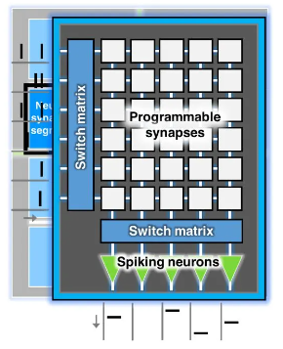
INTRODUCTION
Neuromorphic computing can be implemented using digital, analog, or mixed-signal circuits, as well as with specialized hardware such as memristors.
Neuromorphic computing has potential applications in areas such as machine learning, robotics, and brain-computer interfaces.
The significance of neuromorphic computing lies in its potential to revolutionize computing by enabling machines to process information in ways that are more natural and human-like.

Slide 15
INTRODUCTION
The Problem
SNNs have a larger computational cost
Memory bottlenecks
Difficult to achieve parallelism
Idle power consumption
There is a growing need for specialised architectures purpose-built for SNNs that are scalable and configurable
15

Slide 16

AIM
The aim of our research is to develop a configurable neuromorphic processor architecture for spiking neural networks that uses the RISC-V instruction set architecture, and to demonstrate that architecture is both high-performing and low-power, making it an attractive solution for a range of applications.

Slide 17
OBJECTIVES
To complete the current RISC-v NOC (Network on Chip) FPGA implementation for SNNs and integrate it into the processor architecture.
.
3
To implement a RV32IM pipelined CPU in Verilog as a starting point for the design.
.
To create a test SNN application to verify the functionality and performance of the processor architecture.
.
2
4
1
1
2
To design and implement a Configurable neuromorphic processor architecture for spiking neural networks.
To evaluate the power consumption and speed of the configurable neuromorphic processor architecture and compare it with existing solutions in the literature
1
GO
5

Slide 18
LEARNING OUTCOMES
To become familiar with the RISC-V instruction set architecture and its implementation in hardware
2
3
To gain experience in developing and testing SNN applications.
2
3
1
4
To gain a deep understanding of the principles and concepts of spiking neural networks and neuromorphic computing.
To understand the trade-offs between power consumption, performance, and area in processor architecture design.

Slide 19
METHODOLOGY

Slide 20
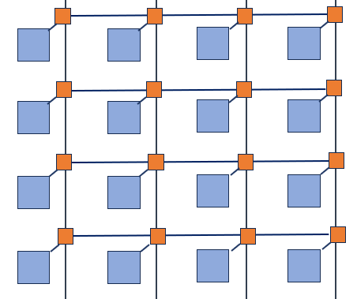
Our Design
METHODOLOGY
Node(Customised RISC-V Core)

Slide 21
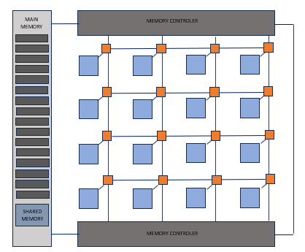
Our Design
METHODOLOGY
Node(Customised RISC-V Core)
Memory
Memory controller

Slide 22
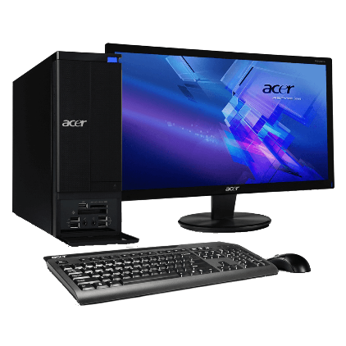
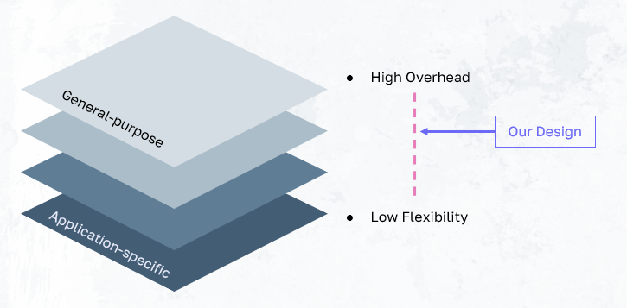
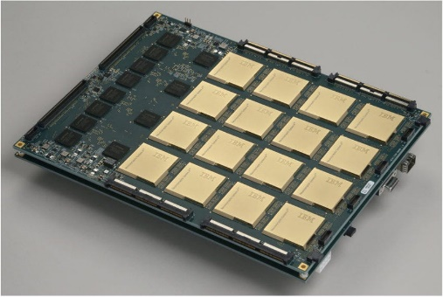
METHODOLOGY
Our Design

Slide 23
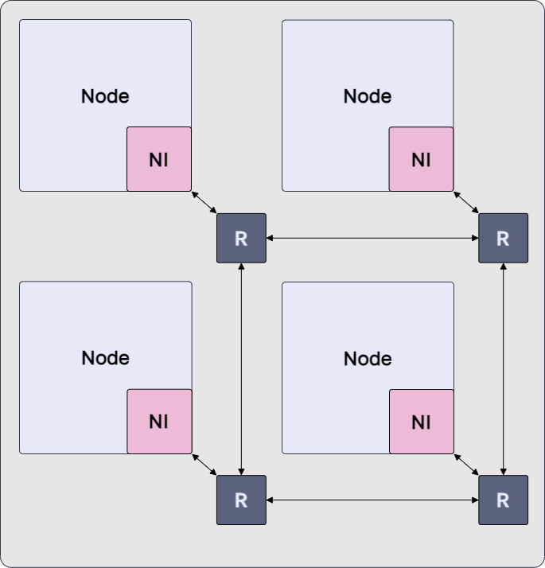
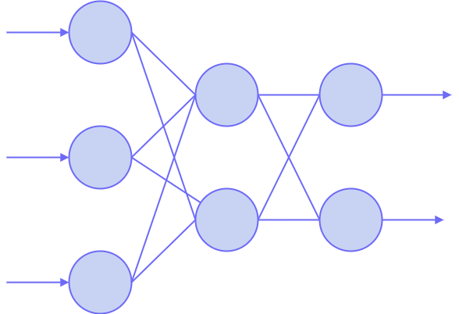
METHODOLOGY
SNN Mapping

Slide 24
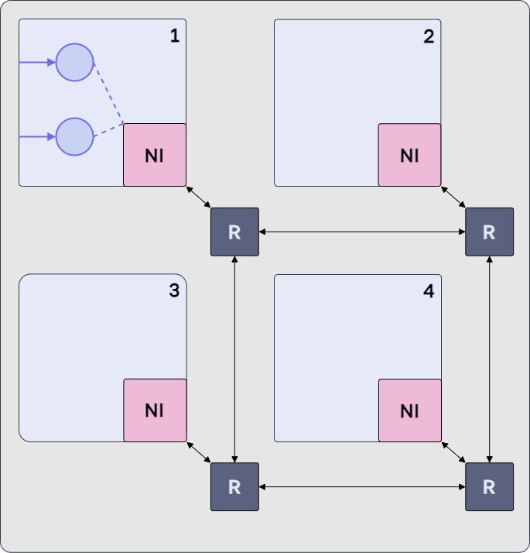
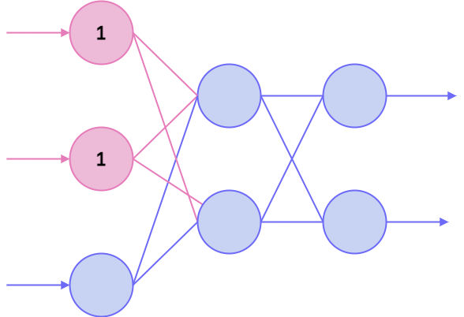
SNN Mapping
METHODOLOGY

Slide 25
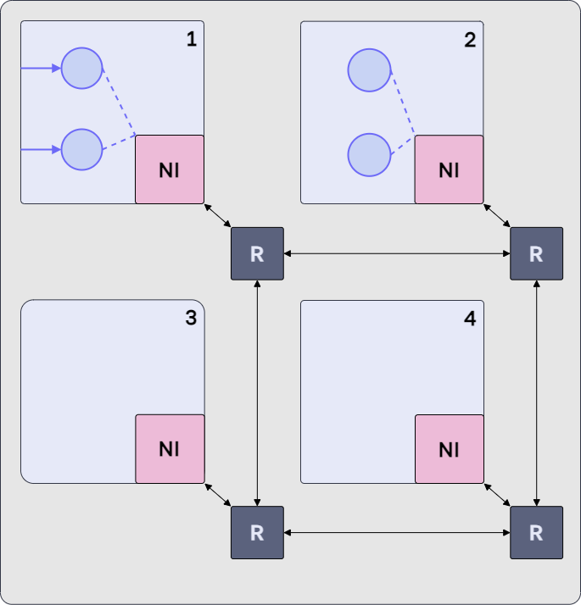
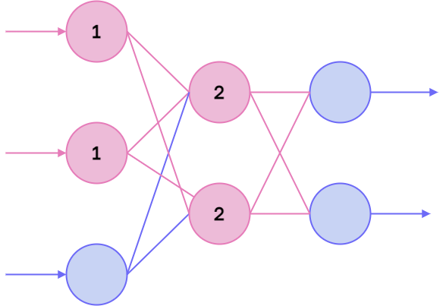
SNN Mapping
METHODOLOGY

Slide 26
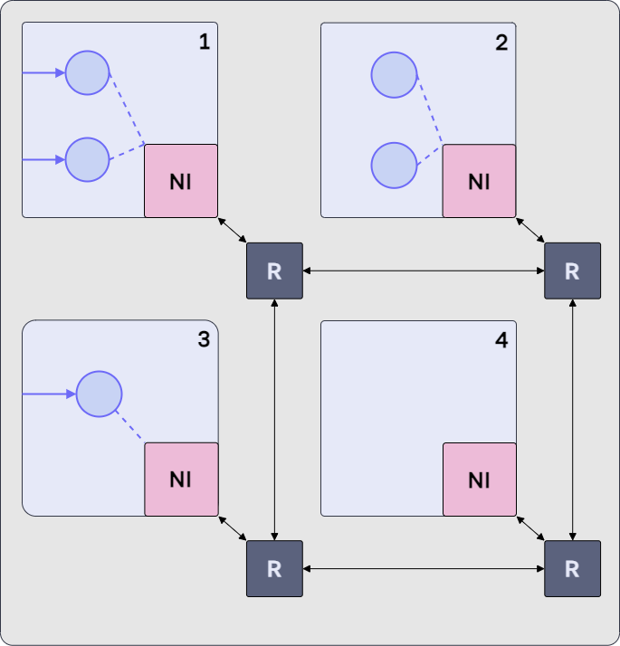
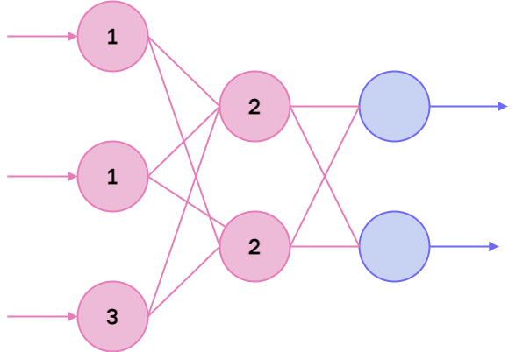
METHODOLOGY
SNN Mapping
26
26
26
26

Slide 27
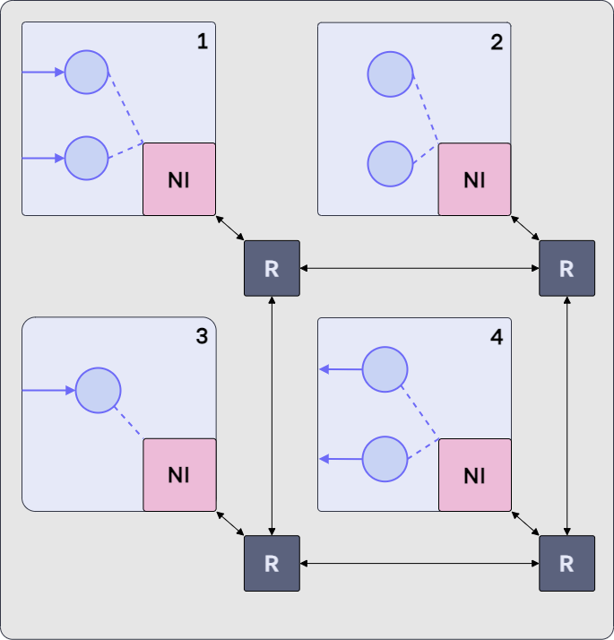
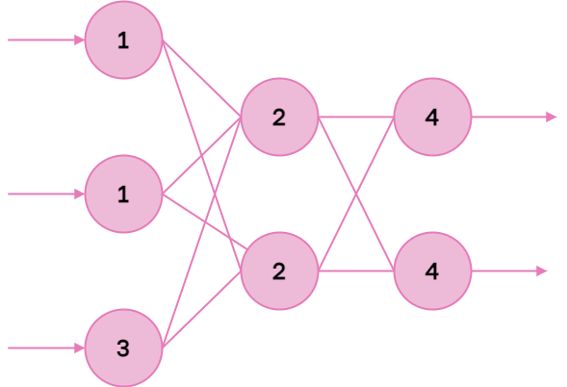
SNN Mapping
METHODOLOGY
27
27
27
27
27

Slide 28
1. RISC V Pipelined CPU implementation 2. NOC Implementation and Testing 3. SNN Software Implementation and Testing on FPGA board
METHODOLOGY

Slide 29
CURRENT PROGRES

Slide 30
CURRENT PROGRESS –CPU Implementation
Node(Customised RISC-V Core)

Slide 31
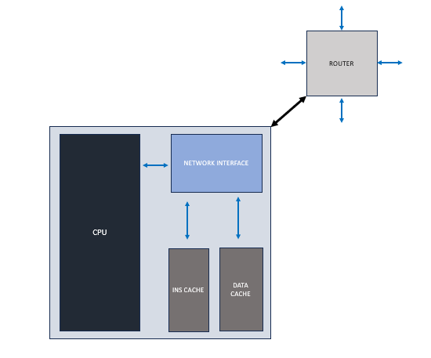
CURRENT PROGRESS –CPU Implementation
Customised RISC-V Core

Slide 32
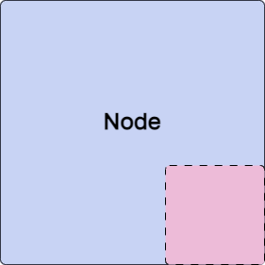

CURRENT PROGRESS –CPU Implementation
32

Slide 33
RISC-V CPU
CURRENT PROGRESS –CPU Implementation
RISC V ISA(RV32IMF)
Five stage pipelined
Support for high parallelism
Customized for Interrupts and Network interface
33

Slide 34
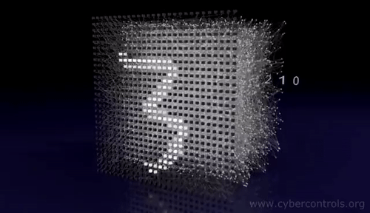
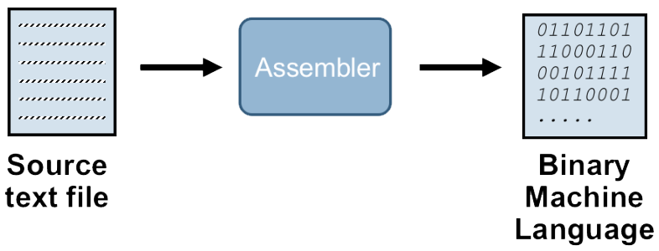
CURRENT PROGRESS –CPU Implementation
Use of CPU Core
CPU

Slide 35
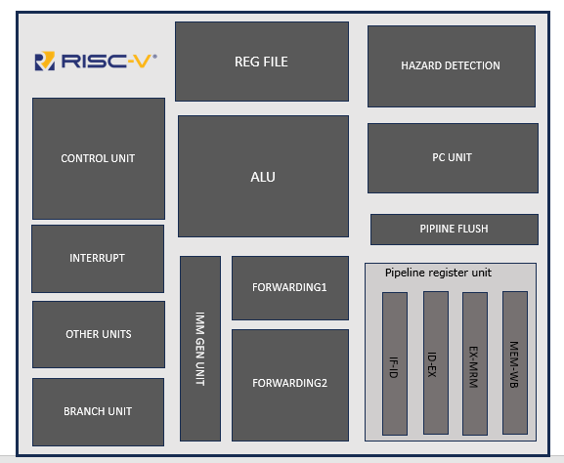
RISC-V CPU
CURRENT PROGRESS –CPU Implementation

Slide 36
RISC-V CPU
CURRENT PROGRESS –CPU Implementation

Slide 37
RISC-V CPU
CURRENT PROGRESS –CPU Implementation

Slide 38
RISC-V CPU
CURRENT PROGRESS –CPU Implementation

Slide 39
RISC-V CPU
CURRENT PROGRESS –CPU Implementation

Slide 40
RISC-V CPU
CURRENT PROGRESS –CPU Implementation

Slide 41
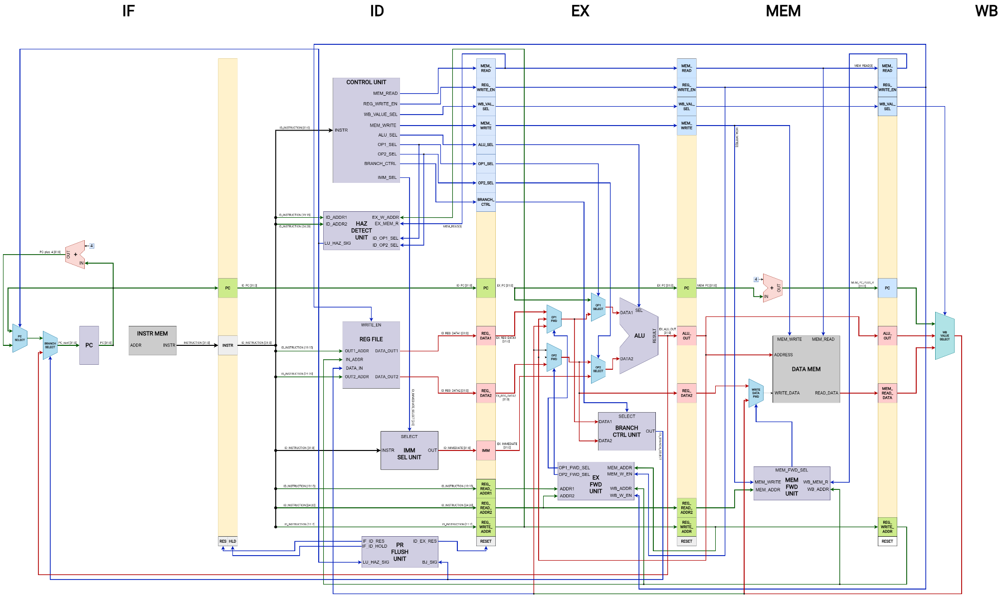
METHODOLOGY-RISC V Core

Slide 42
METHODOLOGY-RISC V Core

Slide 43
METHODOLOGY-RISC V Core

Slide 44
METHODOLOGY-RISC V Core

Slide 45
METHODOLOGY-RISC V Core

Slide 46
METHODOLOGY-RISC V Core

Slide 47
METHODOLOGY-RISC V Core

Slide 48
CURRENT PROGRESS –CPU Implementation
Network Interface

Slide 49
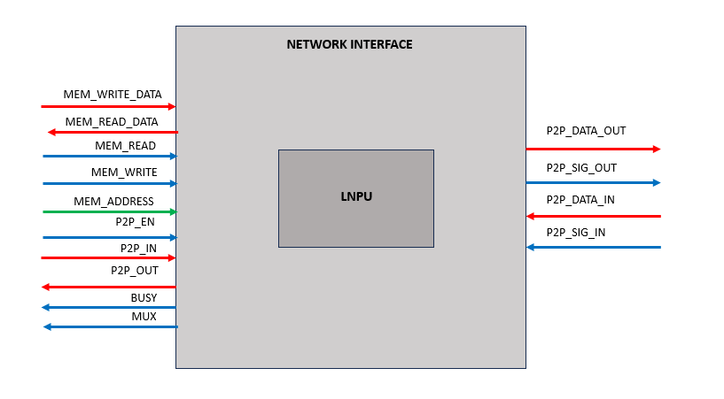
METHODOLOGY-RISC Network interface

Slide 50
CURRENT PROGRESS –CPU Implementation
Router

Slide 51
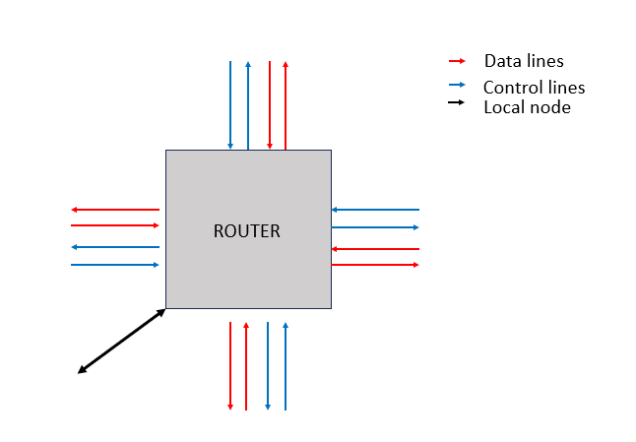
METHODOLOGY-Router

Slide 52
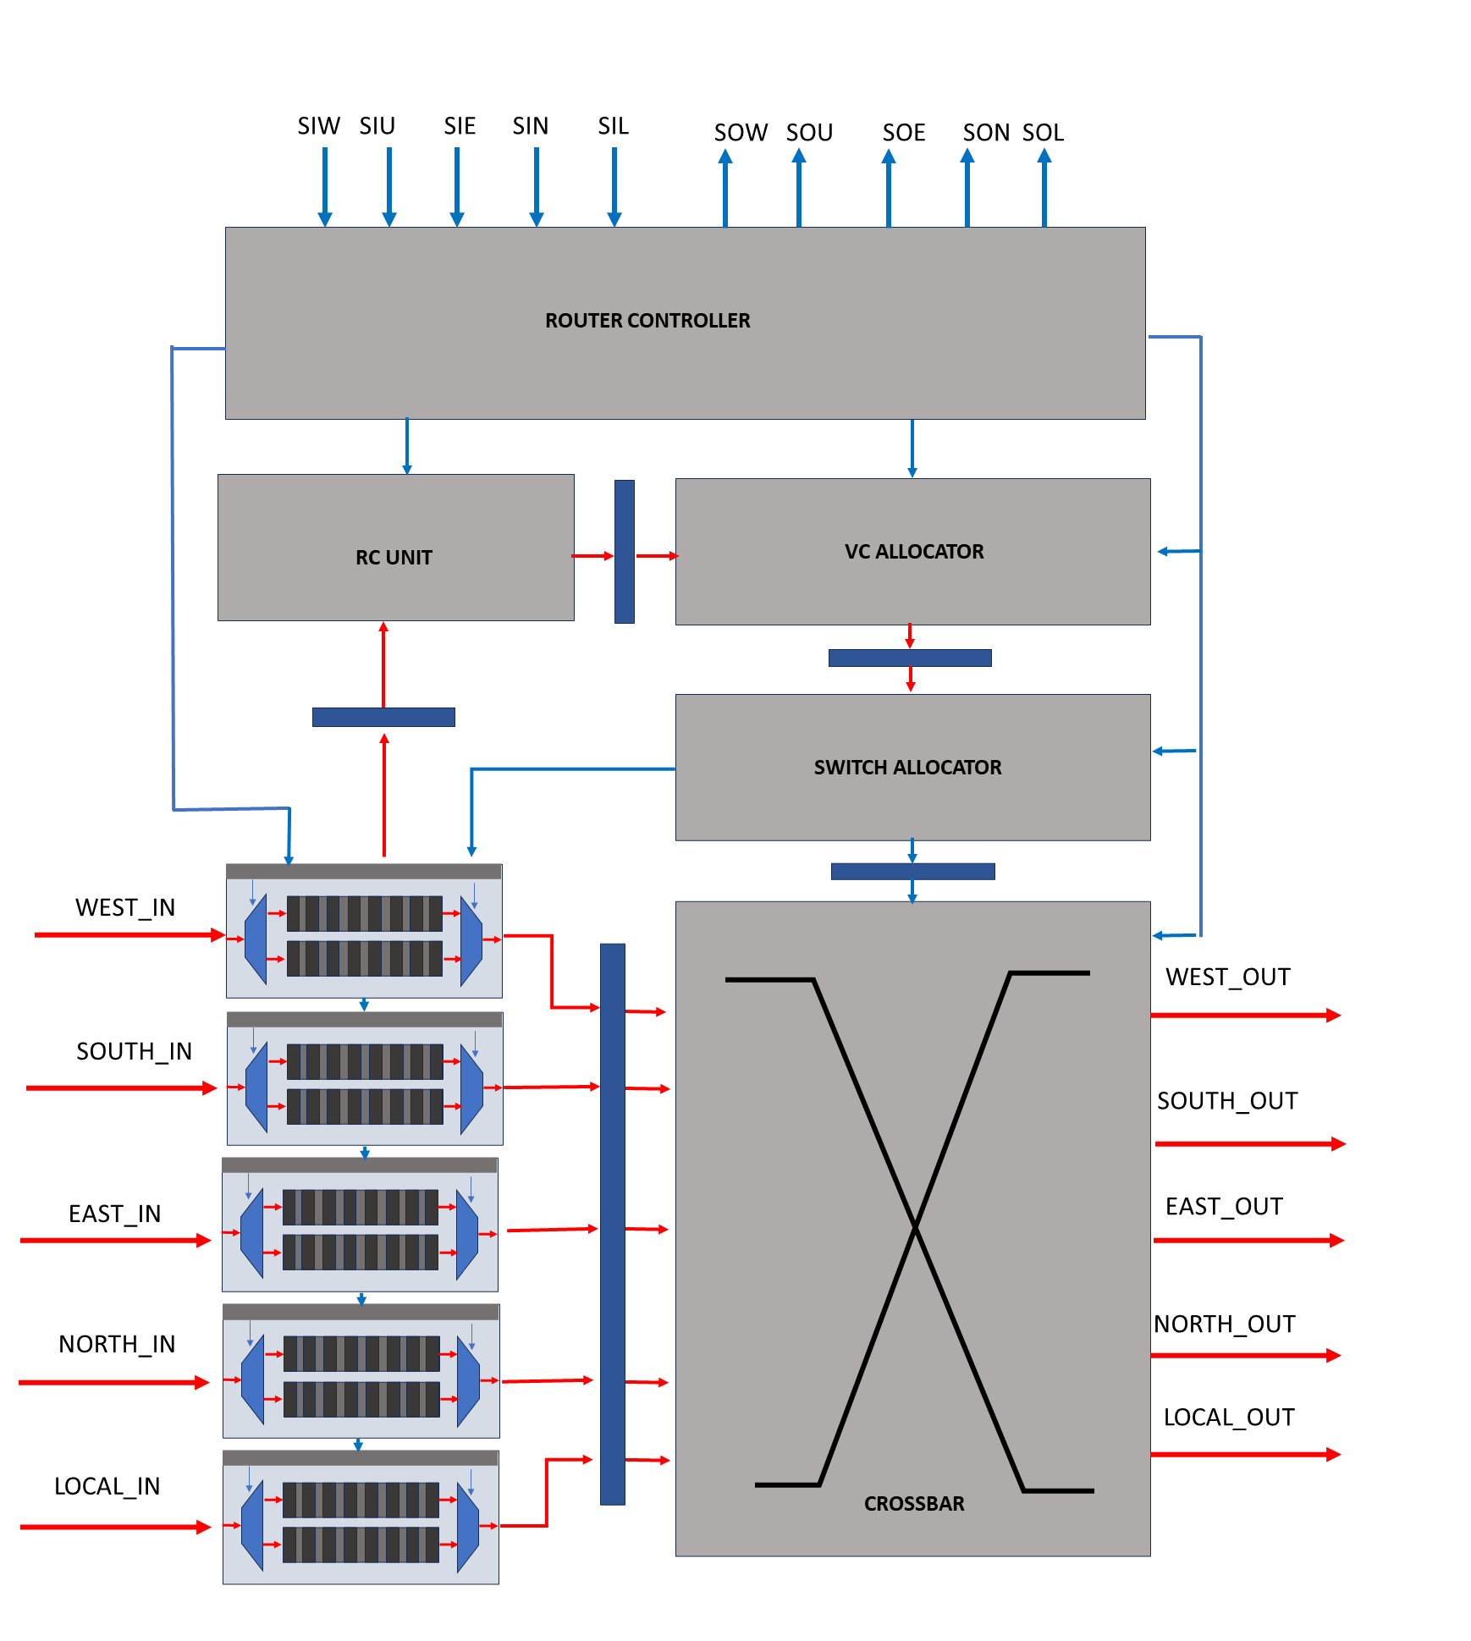
METHODOLOGY-Router

Slide 53
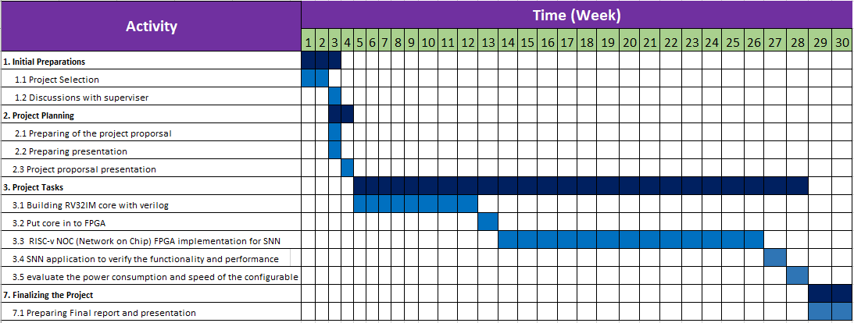
TIMELINE

Slide 54
THANK YOU

